Slide 1

Capstone Project - 2
Title:Transport Demand Prediction
-A Machine Learning Project Using Regression Models
Presented By:- Mayur Chulbhare

Slide 2
Content
What Is Machine Learning?
Why Machine Learning?
Regression Model
Basic Steps Involve In Machine Learning Model
Objective
Problem Description
Data summary
Data Cleaning
Visualizations(Slide 13-19)
Feature Engineering
Target Variable distribution
Heatmap
Regression Models
Model Evaluation Metrics
Train Score
Test Score
Conclusion
Summary
References

Slide 3
What Is Machine Learning?
Machine Learning is the science (and art) of programming computers so they can learn from data.
OR
Machine Learning is the field of study that gives computers the ability to learn without being explicitly programmed

Slide 4
Why Machine Learning?
Problems for which existing solutions require a lot of hand-tuning or long lists of rules, one Machine Learning algorithm can often simplify code and perform better.
Complex problems for which there is no good solution at all using a traditional approach, the best Machine Learning techniques can find a solution.
Fluctuating environments, a Machine Learning system can adapt to new data.
Getting insights about complex problems and large amounts of data.

Slide 5
Regression Model
Regression analysis is a statistical method to model the relationship between a dependent (target) and independent (predictor) variables with one or more independent variables.
A regression analysis is done for one of two purposes:
In order to predict the value of the dependent variable for individuals for whom some information concerning the explanatory variables is available.
To describe the relationships between a set of independent variables and the dependent variable

Slide 6
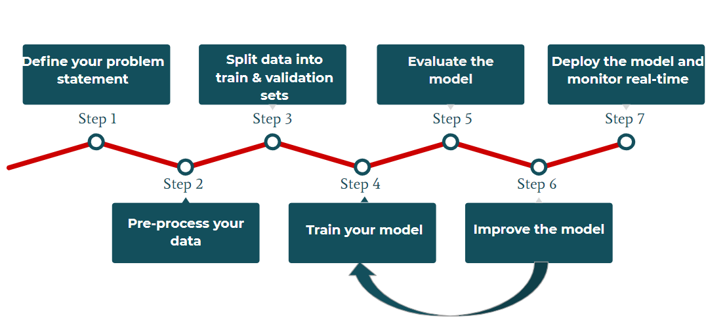
Basic Steps Involve In Machine Learning Model-

Slide 7
Step-1 : Define Your Problem Statement
-Problem statement actually tells about the what is Business goal or what outcomes we want from ML model.
Step-2 : Pre-processing Your Dataset(Exploratory Data Analysis)
- Describing Dataset
- Null value Treatment
- Enriching Dataset by using Conversions,Transformation,Encodings, etc.
Step-3 : Split Data Into Train And Test Sets(Validation)
- Splitting data into train and test datasets such that we can perform various models and conclude whether it generalized or memorised.
- Usually we do 80-20% or 75-25% train-test split.

Slide 8
Step-4 : Train Your Model
Train dataset on each model or on appropriate model according to dataset which gives best results.
Step-5 : Evaluate Your Model
Evaluate performance of model if its bad retrain model and again evaluate
Step-6 : Improve The Model
Improve model metrices by cross validation and hyperparameter tuning.
Step-7 : Deploy The model And real-Time (Optional)

Slide 9

Objective
To build a model that predicts the number of seats that Mobiticket can expect to sell for each ride.

Slide 10

Problem Description
The routes from these 14 origins to the first stop in the outskirts of Nairobi takes approximately 8 to 9 hours from time of departure. From the first stop in the outskirts of Nairobi into the main bus terminal, where most passengers get off, in Central Business District, takes another 2 to 3 hours depending on traffic.
The three stops that all these routes make in Nairobi (in order) are:
1. Kawangware: the first stop in the outskirts of Nairobi
2. Westlands
3. Afya Centre: the main bus terminal where most
passengers disembark

Slide 11
DATA SUMMARY
This dataset includes the variables from 17 October 2017 to 20 April 2018
ride_id: unique ID of a vehicle on a specific route on a specific day and time.
seat_number: seat assigned to ticket
payment_method: method used by customer to purchase ticket from Mobiticket
payment_receipt: unique id number for ticket purchased from Mobiticket
travel_date: date of ride departure. (MM/DD/YYYY)
travel_time: scheduled departure time of ride. Rides generally depart on time. (hh:mm)
travel_from: town from which ride originated
travel_to: destination of ride. All rides are to Nairobi.
car_type: vehicle type (shuttle or bus)
max_capacity: number of seats on the vehicle

Slide 12
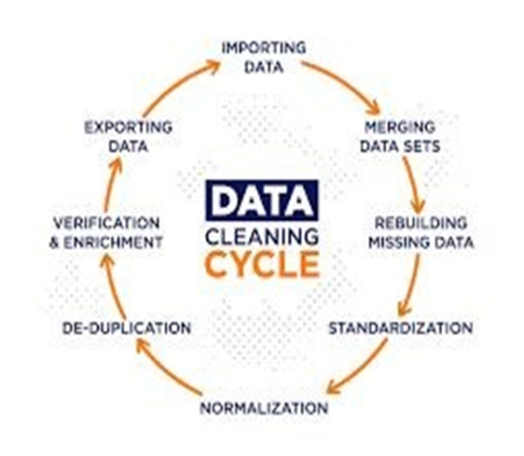
Data Cleaning
Data cleaning is an important early step in the data analytics process in which you either remove or update information that is incomplete, incorrert, improperly formatted, duplicated, or irrelevant .

Slide 13
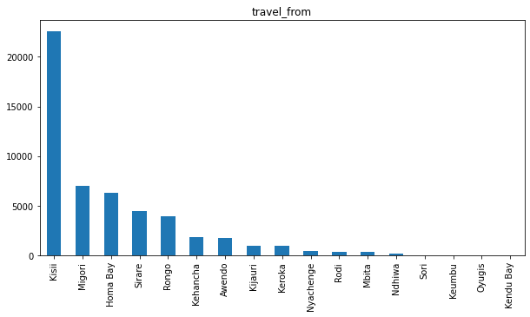
RIDE ORIGINATION TOWNS
Kisii is the top place from where the most number of rides originate.

Slide 14
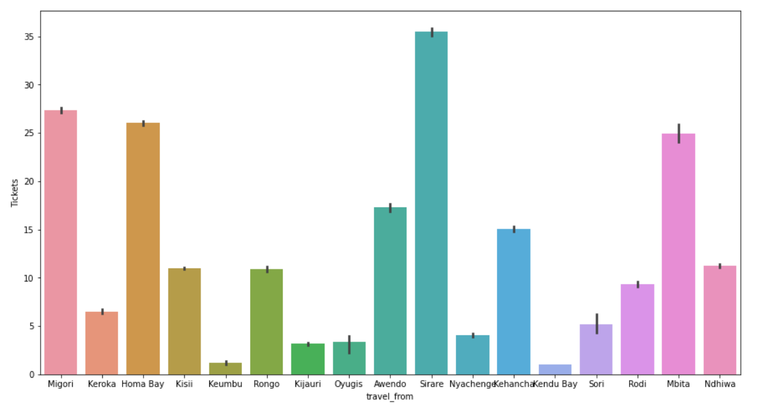
MAXIMUM TICKETS SOLD
Maximum Tickets were sold from Sirare

Slide 15
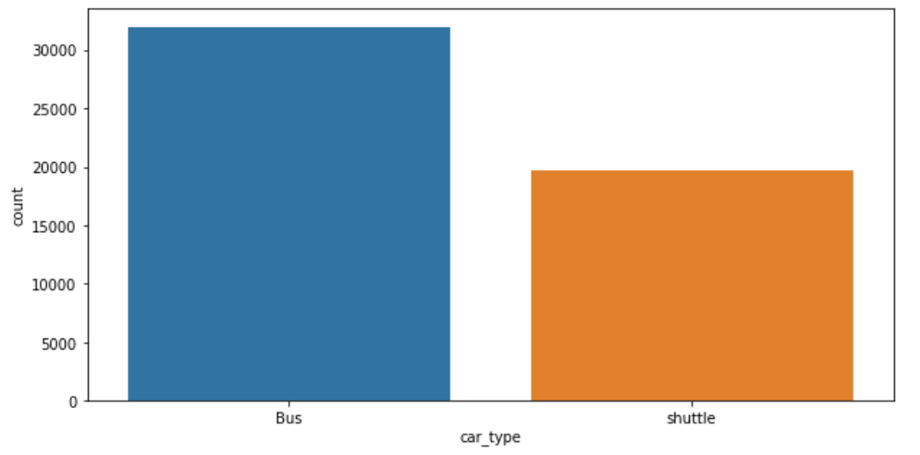
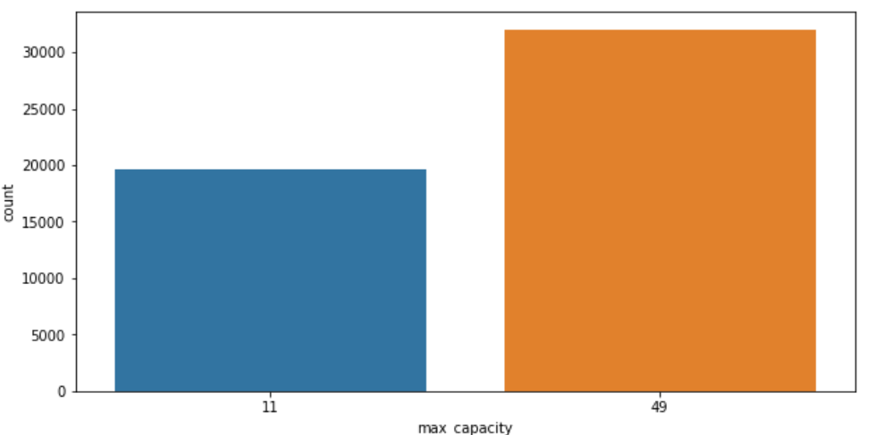
VEHICLE TYPE
There are two type of cars . The most used is Bus with maximum capacity of 49.

Slide 16
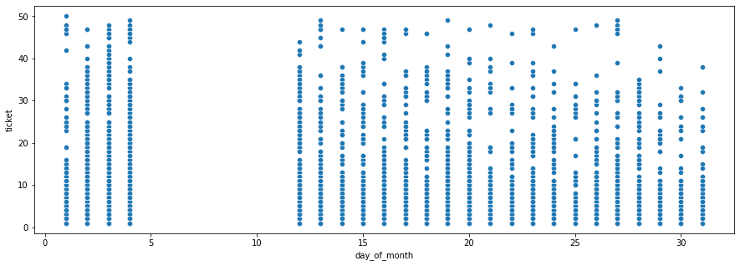
DAY WISE TRAVEL TREND
The frequency of the rides are almost similar among the days of the month,
There are no rides between 4th to 11th of every month, but this might be because of missing data

Slide 17
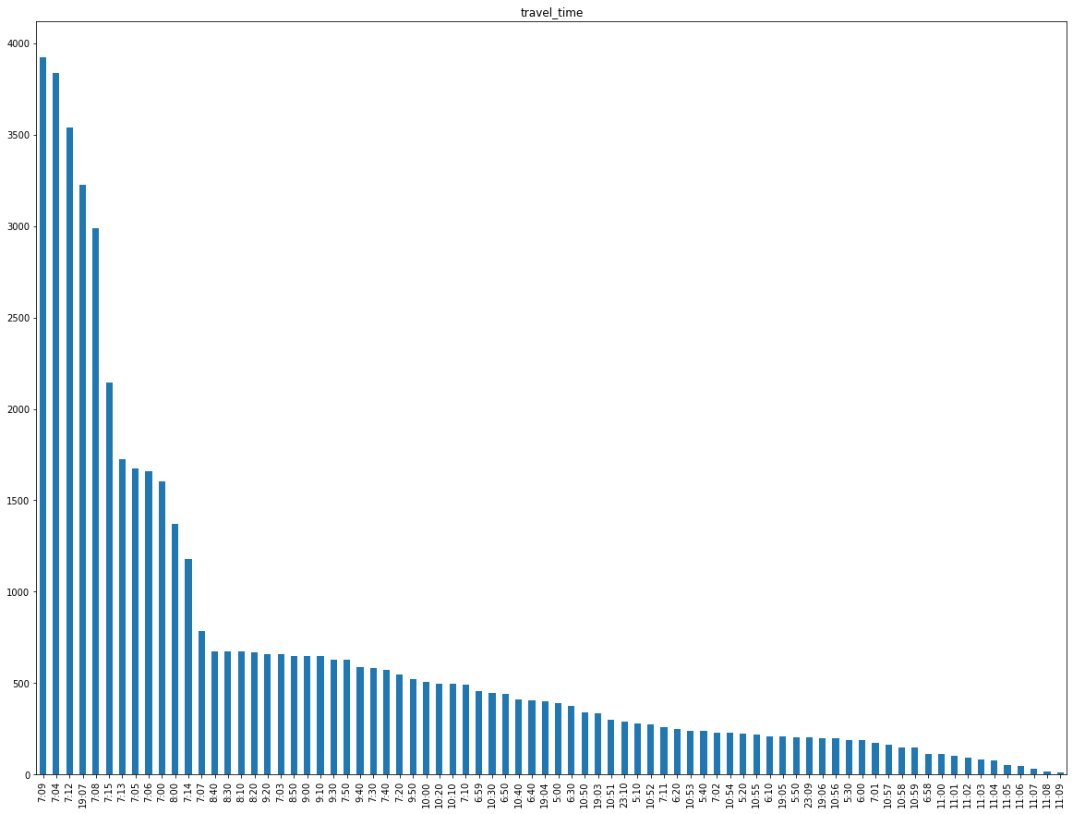
DEPARTURE TIME
Highest number of buses depart at around 7 AM in the Morning

Slide 18
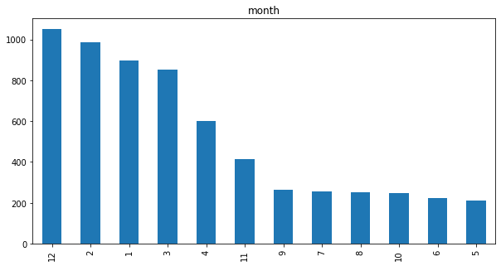
MONTH-WISE RIDES TRENDS
During the month of December, February and January there are more number of rides, and least during the months of May and June.

Slide 19
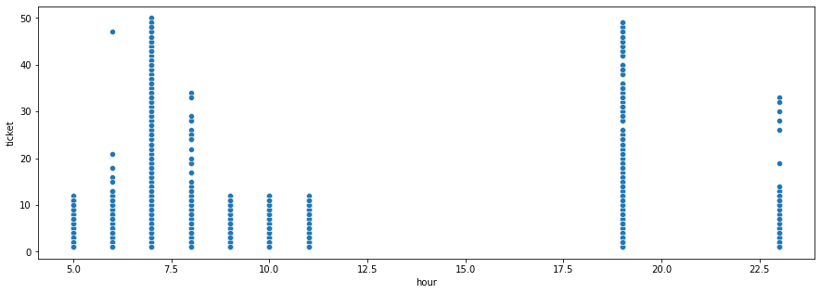
HOURLY TRAVEL TREND
The frequency of rides are more in the Morning hours and during the night times.

Slide 20
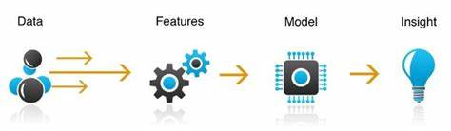
FEATURE ENGINEERING
Using domain knowledge to extract features from raw data, the performance of the model can be improved.
Speed
Tickets
travel_day
Travel_from
hourly_travelers
daily_travelers
Since we don’t have any target variable so we have created a featured name Ticket and considered
it as a Target variable since we are predicting the demand of travel transportation

Slide 21
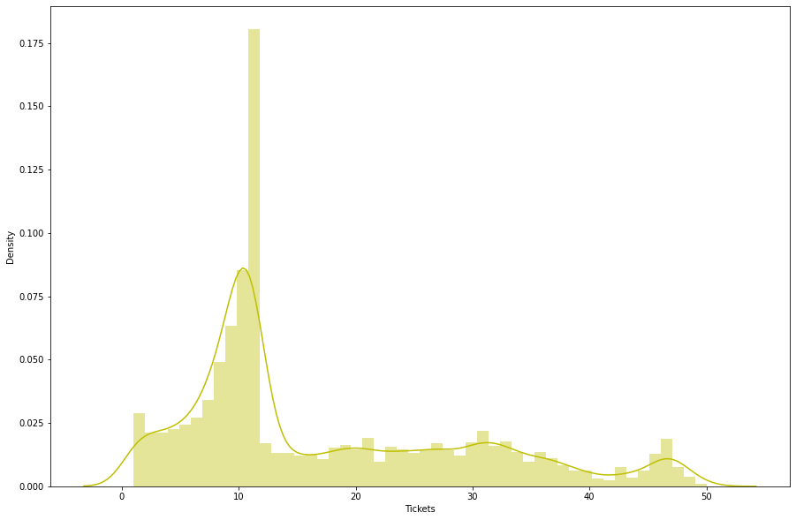
TARGET VARIABLE DISTRIBUTION
We can see our target
variable “Tickets” is positively
skewed(Right skewed

Slide 22
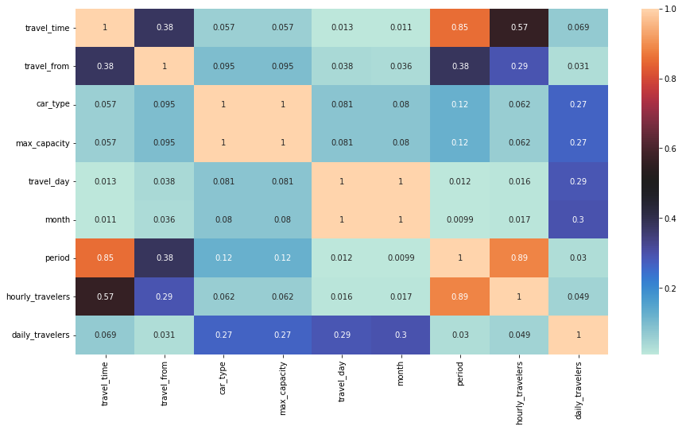
HEAT MAP
We can see the correlation between the data columns
There is a high correlation between car type and max_capacity features and also period and hourly_travelers
Hence we are dropping the multi-collinearity features

Slide 23
Regression Models
Linear Regression
Lasso Regression (L1 Regularization)
Ridge Regression (L2 Regularization)
Elastic - Net Regression (Combined L1 & L2 Regularization)
Decision tree
Random forest
XGB Regression
Random forest with GridsearchCV
XGB Regressor with GridsearchCV

Slide 24





Model Evaluation Metrics
MSE (Mean Squared Error):
RMSE (Root Mean Squared Error):
MAE (Mean Absolute Error):
R-Squared:
Adjusted R-Squared:

Slide 25
Linear Regression
Linear Regression is a supervised machine learning algorithm where the predicted output is continuous and has a constant slope. It’s used to predict values within a continuous range, rather than trying to classify them into categories. There are two main types:
Simple regression :
Simple linear regression uses traditional slope-intercept form, where m and b are the variables our algorithm will try to “learn” to produce the most accurate predictions. x represents our input data and y represents our prediction.
y=mx+b
Multivariable regression :
A more complex, multi-variable linear equation might look like this, where w represents the coefficients, or weights, our model will try to learn.
f(x,y,z)=w1x+w2y+w3z

Slide 26
2. Lasso Regression(L1 Regularization)
Lasso regression stands for Least Absolute Shrinkage and Selection Operator. It adds penalty term to the cost function. This term is the absolute sum of the coefficients. As the value of coefficients increases from 0 this term penalizes, cause model, to decrease the value of coefficients in order to reduce loss. The difference between ridge and lasso regression is that it tends to make coefficients to absolute zero as compared to Ridge which never sets the value of coefficient to absolute zero.
Limitation of Lasso Regression :
Lasso sometimes struggles with some types of data.
If the number of predictors (p) is greater than the number of observations (n)
Lasso will pick at most n predictors as non-zero, even if all predictors are relevant (or may be used in the test set)
If there are two or more highly collinear variables then LASSO regression select one of them randomly which is not good for the interpretation of data

Slide 27
3. Ridge Regression (L2 Regularization)
In Ridge regression, we add a penalty term which is equal to the square of the coefficient. The L2 term is equal to the square of the magnitude of the coefficients.
We also add a coefficient lambda to control that penalty term. In this case if lambda is zero then the equation is the basic OLS else if lambda > 0 then it will add a constraint to the coefficient.
As we increase the value of lambda this constraint causes the value of the coefficient to tend towards zero. This leads to tradeoff of higher bias (dependencies on certain coefficients tend to be 0 and on certain coefficients tend to be very large, making the model less flexible) for lower variance.
Limitation of Ridge Regression :
Ridge regression decreases the complexity of a model but does not reduce the number of variables since it never leads to a coefficient been zero rather only minimizes it. Hence, this model is not good for feature reduction.

Slide 28
4. Elastic - Net Regression
Called as combined Ridge and Lasso Regression or Combined L1 & L2 regularization
Sometimes, the lasso regression can cause a small bias in the model where the prediction is too dependent upon a particular variable.
In these cases, elastic Net is proved to better it combines the regularization of both lasso and Ridge.
The advantage of that it does not easily eliminate the high collinearity coefficient.

Slide 29
5. Decision Trees
Decision trees can be used for classification as well as regression problems.
Decision trees are upside down which means the root is at the top and then this root is split into various several nodes. It checks if the condition is true and if it is then it goes to the next node attached to that decision.
In a Decision Tree diagram, we have:
Root Node: The first split which decides the entire population or sample data should further get divided into two or more homogeneous sets.
Splitting : It is a process of dividing a node into two or more sub-nodes.
Decision Node : This node decides whether/when a sub-node splits into further sub-nodes or not. Here we have, Outlook node, Humidity node, and Windy node.
Leaf : Terminal Node that predicts the outcome (categorical or continuous value). The coloured nodes, i.e., Yes and No nodes, are the leaves.

Slide 30
6. Random Forest Regressor
Random Forest is a technique that uses ensemble learning, that combines many weak classifiers to provide solutions to complex problems.
As the name suggests random forest consists of many decision trees. Rather than depending on one tree it takes the prediction from each tree and based on the majority votes of predictions, predicts the final output.
Random forests use the bagging method. It creates a subset of the original dataset, and the final output is based on majority ranking and hence the problem of overfitting is taken care off.
Random forest with hyper tuning parameter performances well

Slide 31
7. XGB Regression
XGBoost is a powerful approach for building supervised regression models.
The validity of this statement can be inferred by knowing about its (XGBoost) objective function and base learners.
The objective function contains loss function and a regularization term. It tells about the difference between actual values and predicted values, i.e how far the model results are from the real values.
The most common loss functions in XGBoost for regression problems is reg:linear, and that for binary classification is reg:logistics.
Ensemble learning involves training and combining individual models (known as base learners) to get a single prediction, and XGBoost is one of the ensemble learning methods.
XGBoost expects to have the base learners which are uniformly bad at the remainder so that when all the predictions are combined, bad predictions cancels out and better one sums up to form final good predictions.

Slide 32
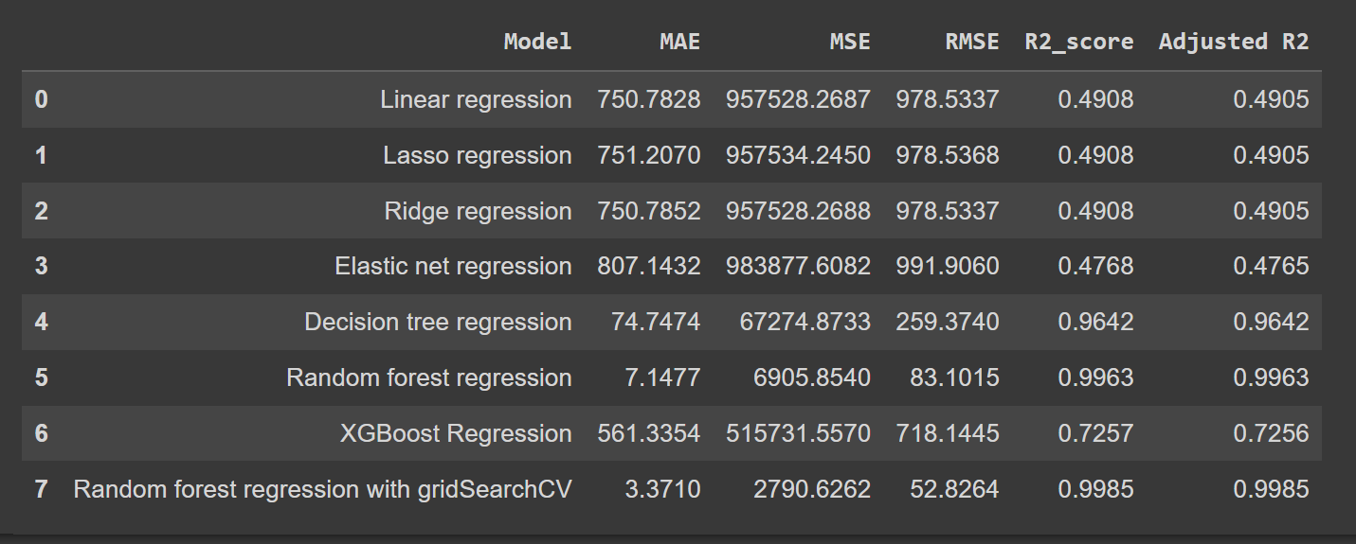
Train score

Slide 33
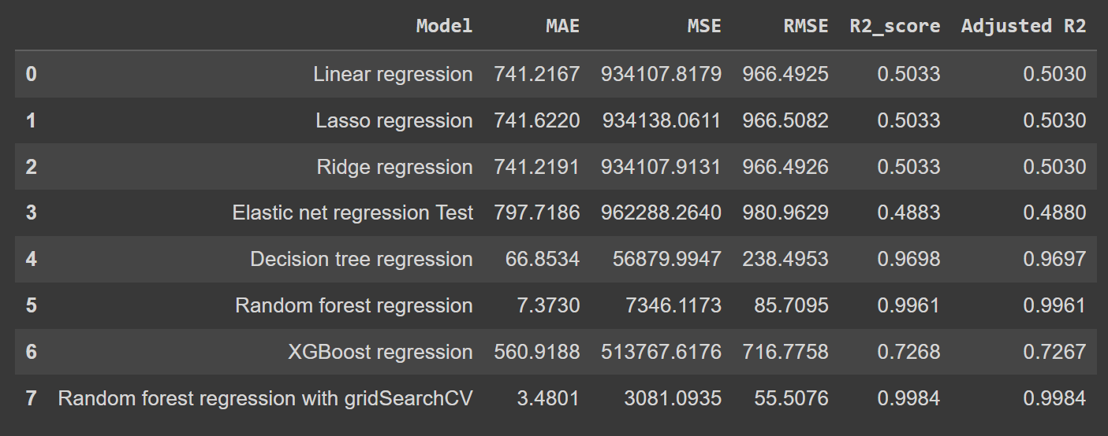
Test Score

Slide 34
CONCLUSION
We were able to see that the linear algorithms were not performing optimally even with Gradient Boosting optimization, and the tree-based algorithms performed significantly better.
We were able to achieve an R2 score of 0.9967 in the train split, and 0.9964 in the test split. We also noticed that even in the case of Decision tree, we were able to achieve an R2 score of 0.97 in the test split.
Once we found the best model to work with, then we implemented Grid Search Cross Validation (on Random Forest Regressor), to further optimize the model, and were able to achieve an R2 score of 0.9985 in the train split, and 0.9984 (at best it gave 0.99) in the test split.
Finally, we conclude Random Forest with GridSearchCV to be the best model to achieve our objective.

Slide 35
SUMMARY
The data was cleaned and created the new dataframe were columns we required for the analysis. Each and every columns were compared to gain the knowledge about the data. Worked individually gaining some insights doing some EDA.
The first problem we faced was the name of the columns and nan values present in the data.
By getting info of dataframe we plotted graphs for each data to understand and visualized thoroughly.
We split the data into training and testing to predict model.
We predicted modelling by using Linear Regressor, Regularized linear regression (Ridge and Lasso), Random Forest, Decision Tree, XGboost regresssor and Also we tuned the parameters of XGboost regressor and also found the important features for training the model.
Out of them Random Forest with tuned hyperparameters gave the best result.

Slide 36
References
● Python Pandas Documentation
https://pandas.pydata.org/pandas-docs/stable
● Python MatPlotLib Documentation
https://matplotlib.org/stable/index.html
● Python Seaborn Documentation
https://seaborn.pydata.org
● Python SkLearn Documentation
https://scikit-learn.org/stable

Slide 37
THANK YOU

